Slide 1
Customer Review Analysis
British Airways (BA) is the flag carrier airline of the United Kingdom (UK). Every day, thousands of BA flights arrive to and depart from the UK, carrying customers across the world. Whether it’s for holidays, work or any other reason, the end-to-end process of scheduling, planning, boarding, fuelling, transporting, landing, and continuously running flights on time, efficiently and with top-class customer service is a huge task with many highly important responsibilities.

Slide 2
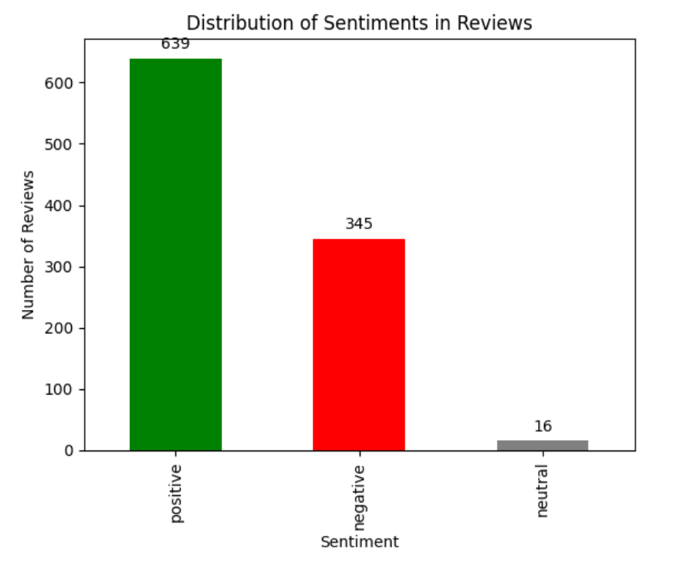
Distribution of Sentiments in Reviews Customers who book a flight with BA will experience many interaction points with the BA brand. Understanding a customer's feelings, needs, and feedback is crucial for any business, including BA. This first task is focused on scraping and collecting customer feedback and reviewing data from a third-party source and analysing this data to present any insights. The bar graph illustrates the distribution of sentiments in a sample of airline reviews. The sentiments are categorized as positive, negative, and neutral. The majority of reviews express a positive sentiment, with 639 instances, followed by 345 negative sentiments. A smaller number of reviews fall into the neutral category, with 16 instances. This distribution provides an overview of the overall sentiment landscape within the collected reviews.

